Slide 1

DevOps – Overview
Copyright © 2016 HCL Technologies Limited | www.hcltech.com

Slide 2
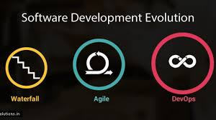
EVOLUTION OF SOFTWARE DEVELOPMENT
Copyright © 2016 HCL Technologies Limited | www.hcltech.com

Slide 3
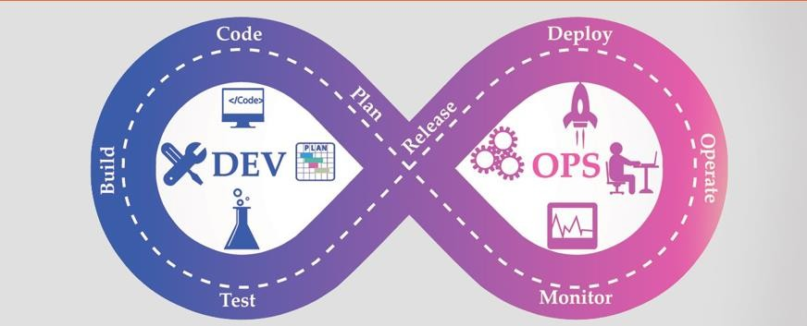
DEVOPS
Copyright © 2016 HCL Technologies Limited | www.hcltech.com

Slide 4
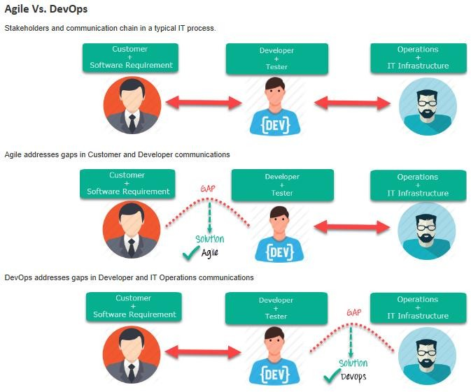
Why Agile and DevOps
Copyright © 2016 HCL Technologies Limited | www.hcltech.com

Slide 5
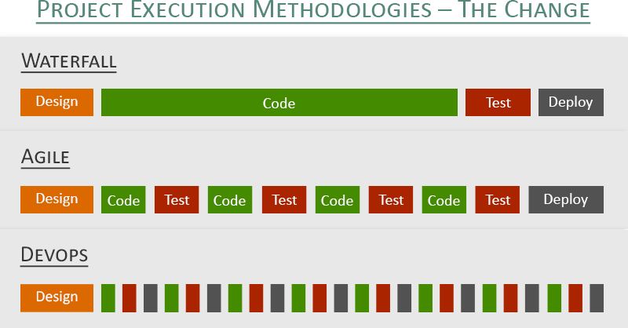
PROJECT EXECUTION METHODOLOGIES
Waterfall
A set of principles that enables greater flexibility, increased transparency, and the ability to adapt to change.
Requirements are not fixed and changes frequently
Development Cycles are short
Agile
Requirements are not fixed and changes frequently
Dev Needs to be Agile Ops Needs to be Agile
.
DevOps
Copyright © 2016 HCL Technologies Limited | www.hcltech.com

Slide 6
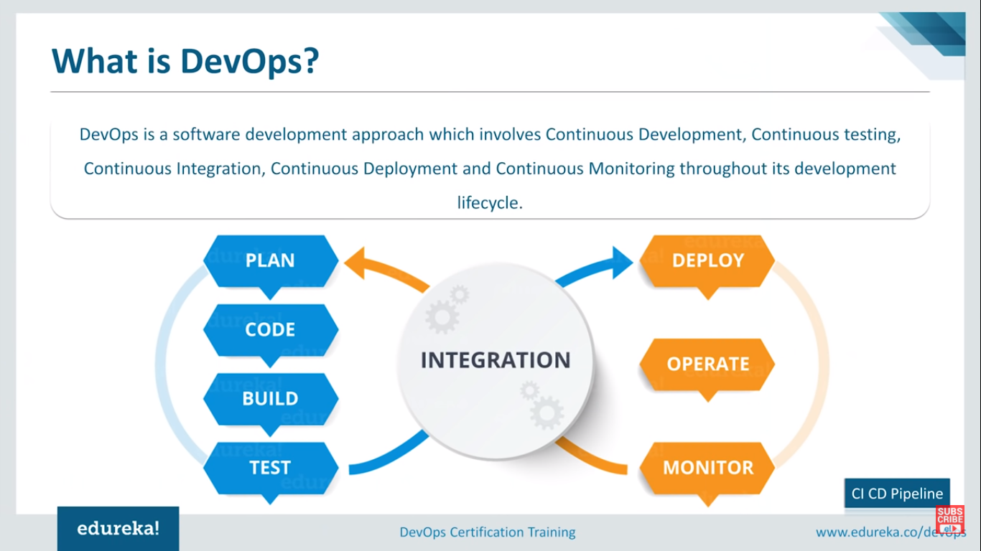

Slide 7
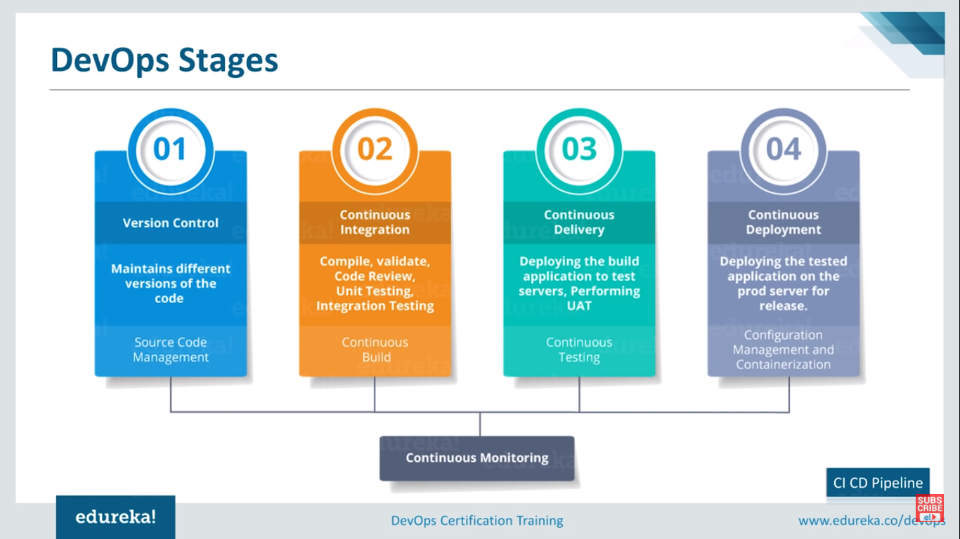

Slide 8
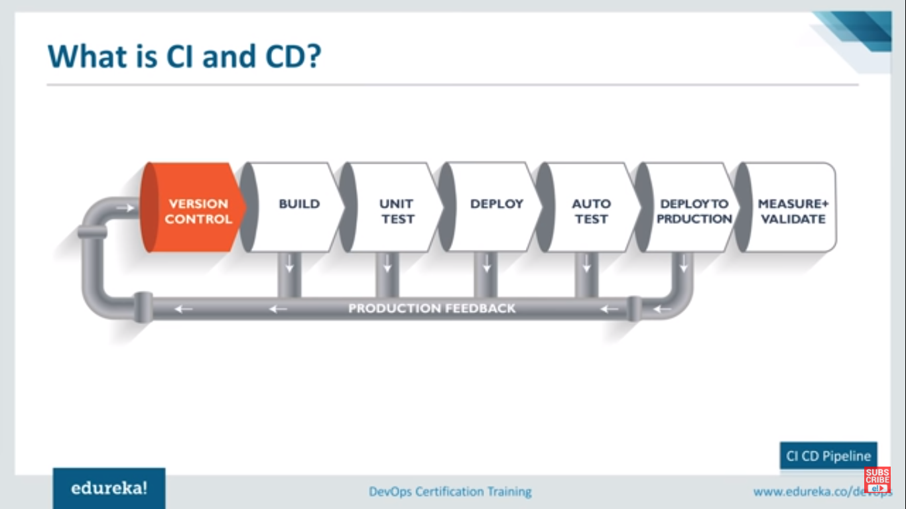

Slide 9
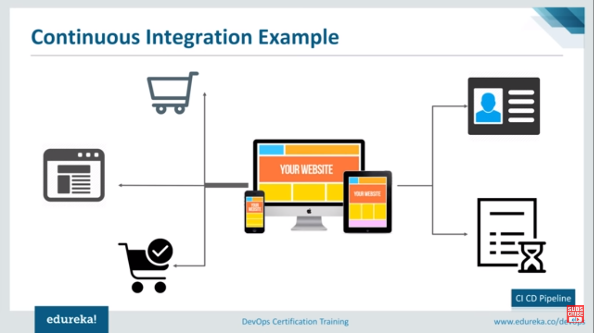

Slide 10
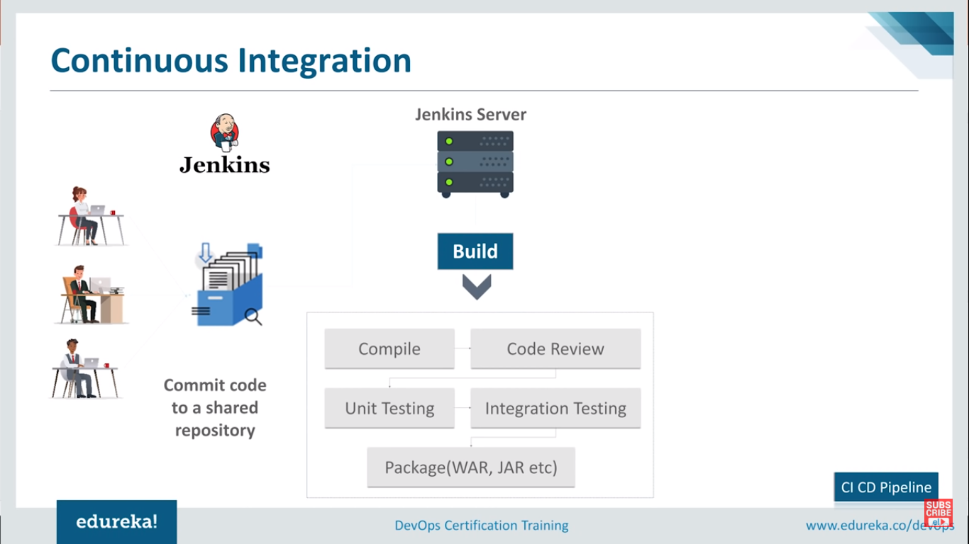

Slide 11
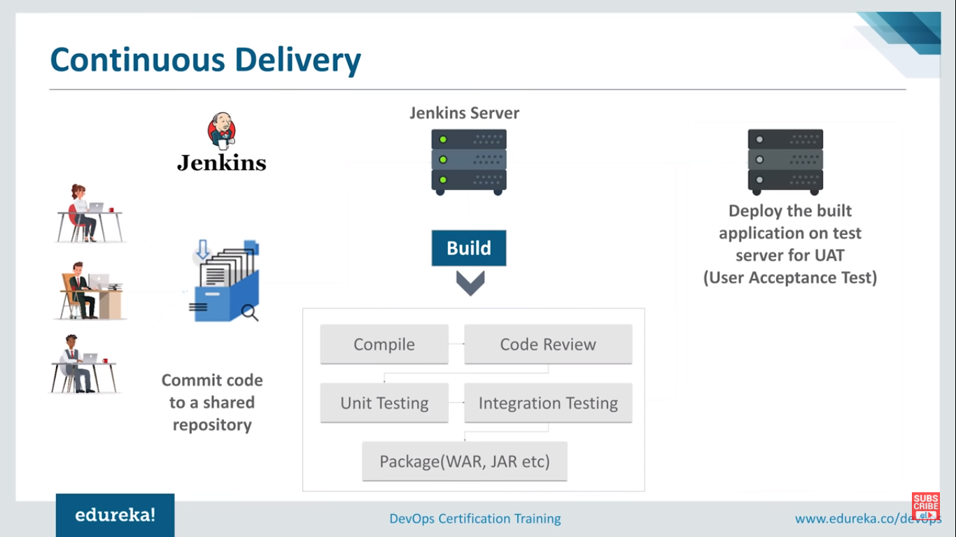

Slide 12
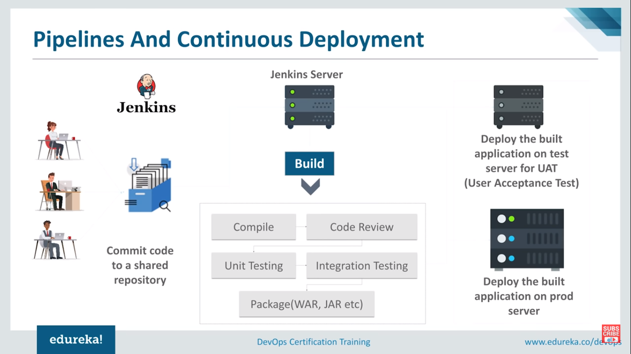

Slide 13
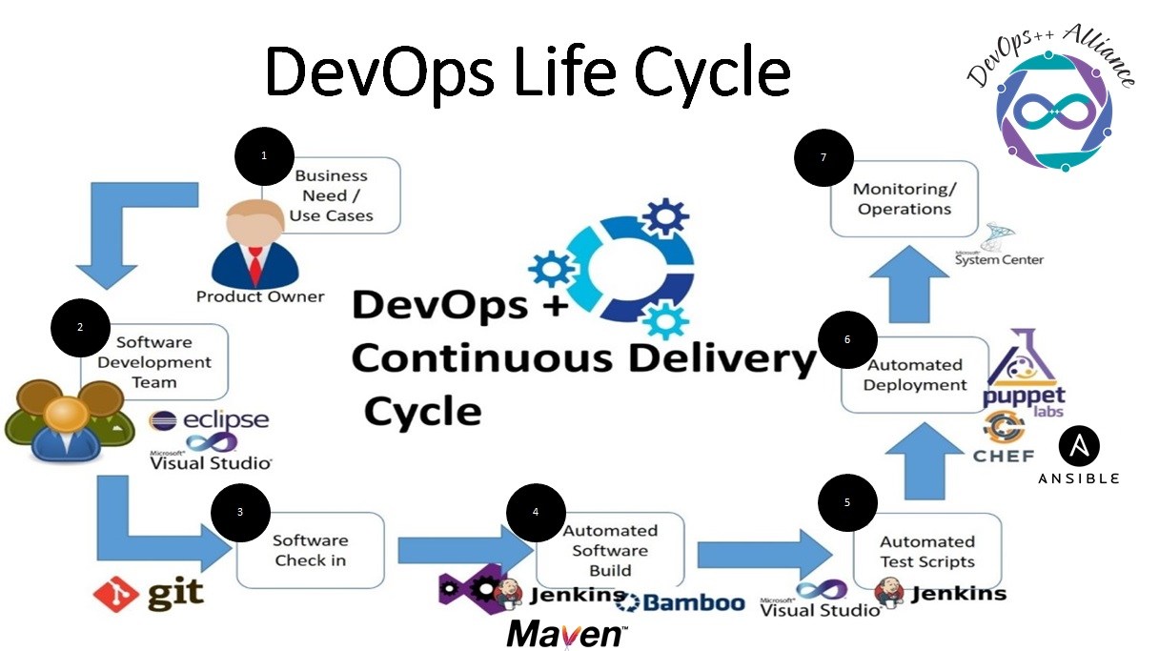

Slide 14
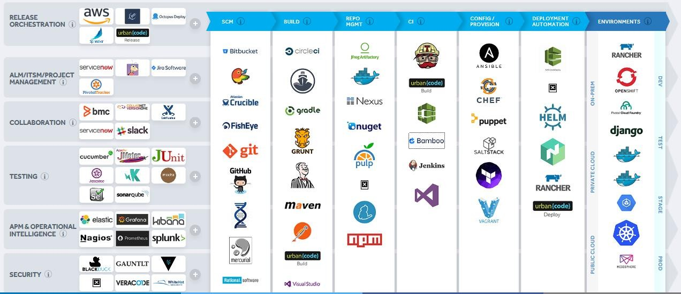
DevOps Tool Chain
Copyright © 2016 HCL Technologies Limited | www.hcltech.com

Slide 15
What is version control ?

Slide 16
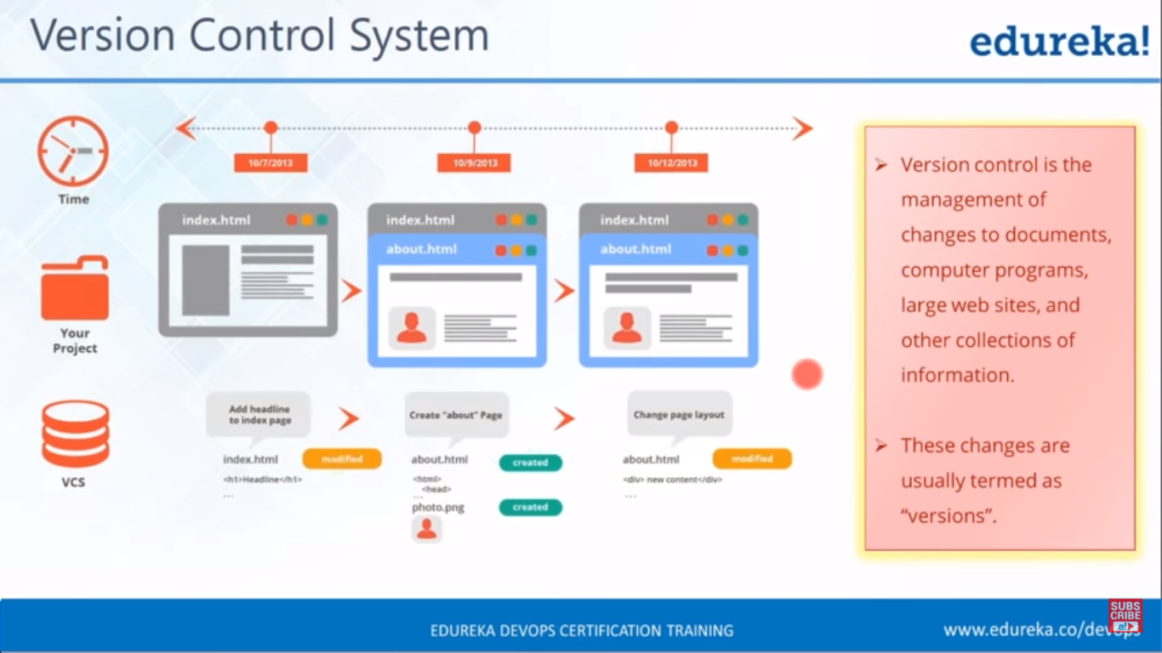

Slide 17
Why Version Control ?

Slide 18
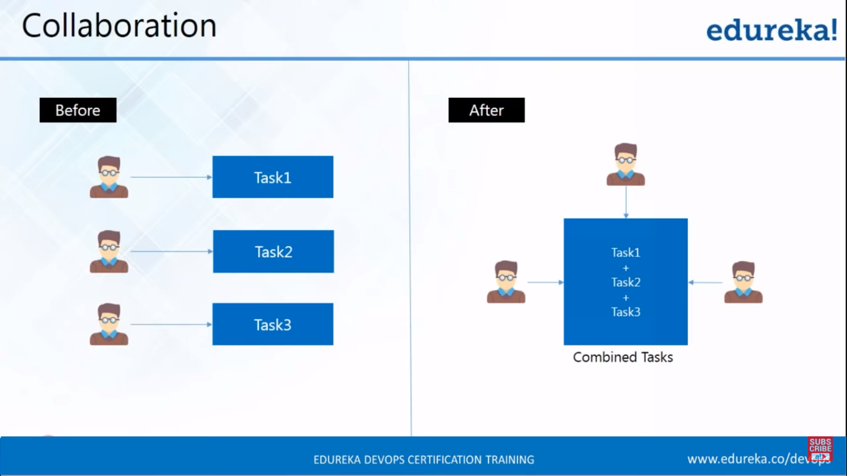

Slide 19
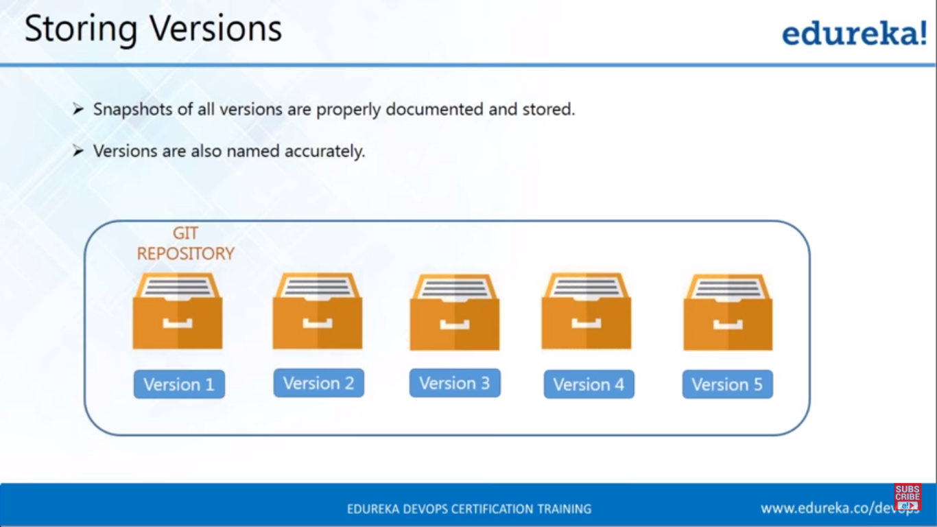

Slide 20
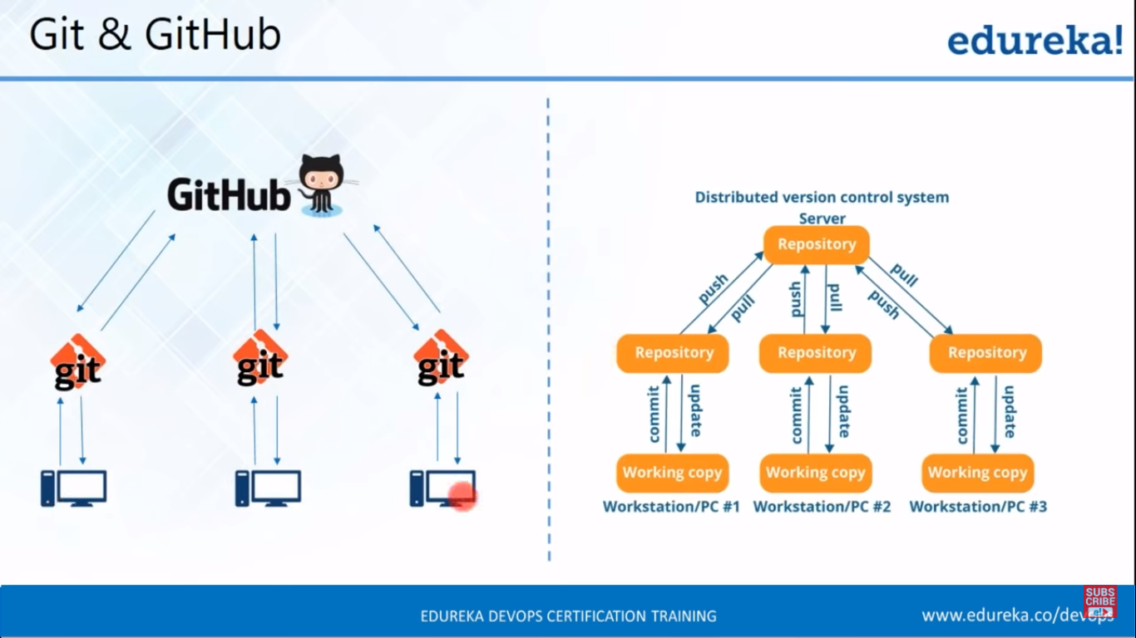

Slide 21
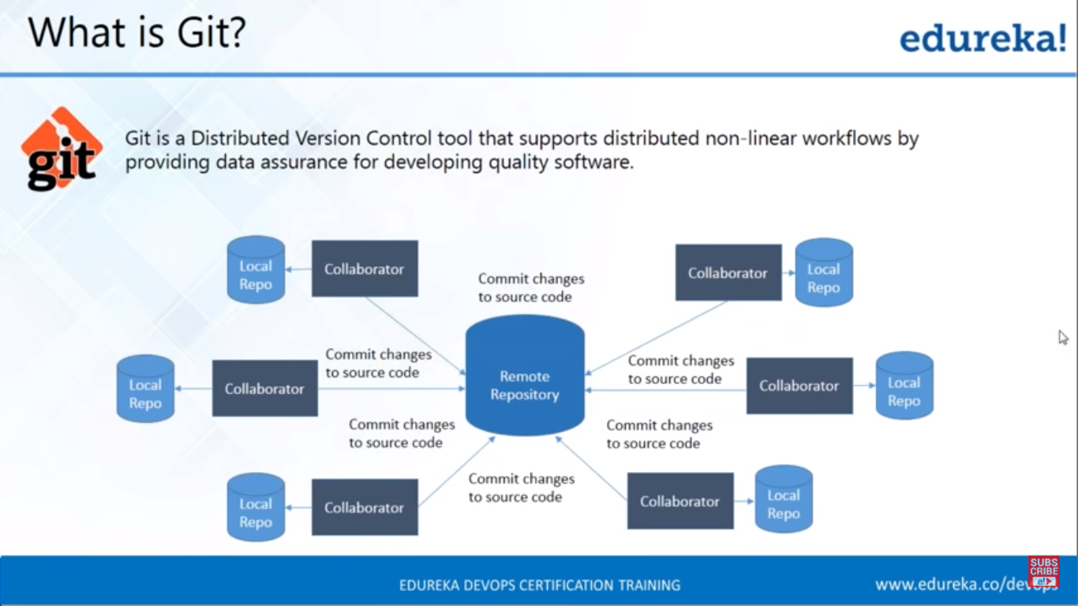

Slide 22
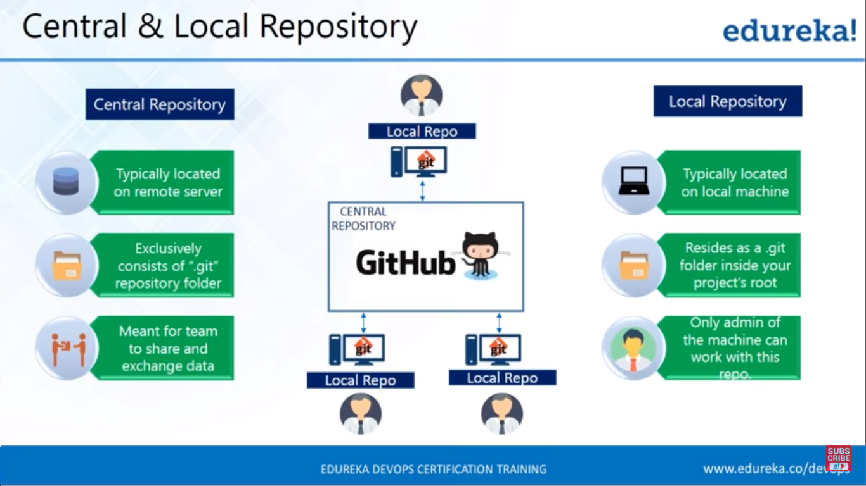

Slide 23
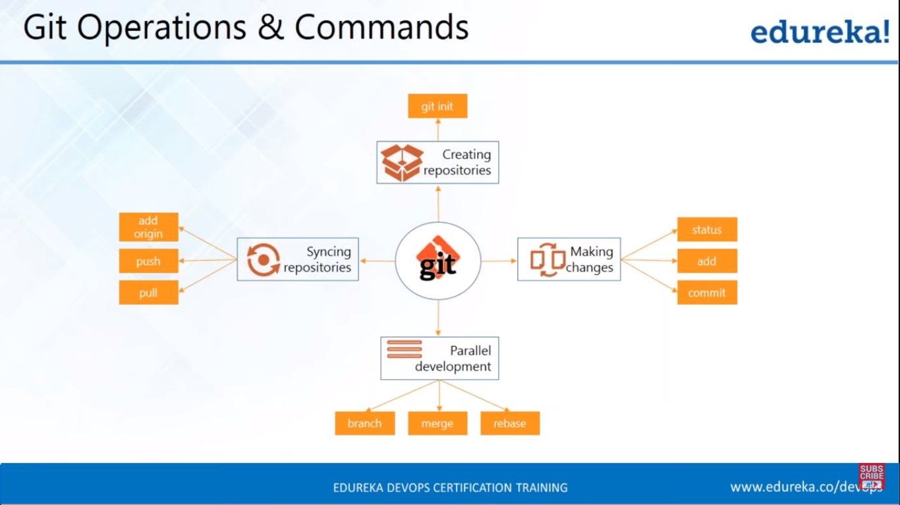

Slide 24
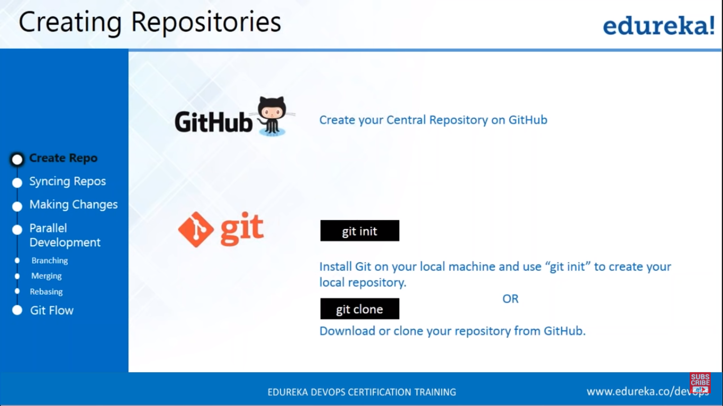

Slide 25
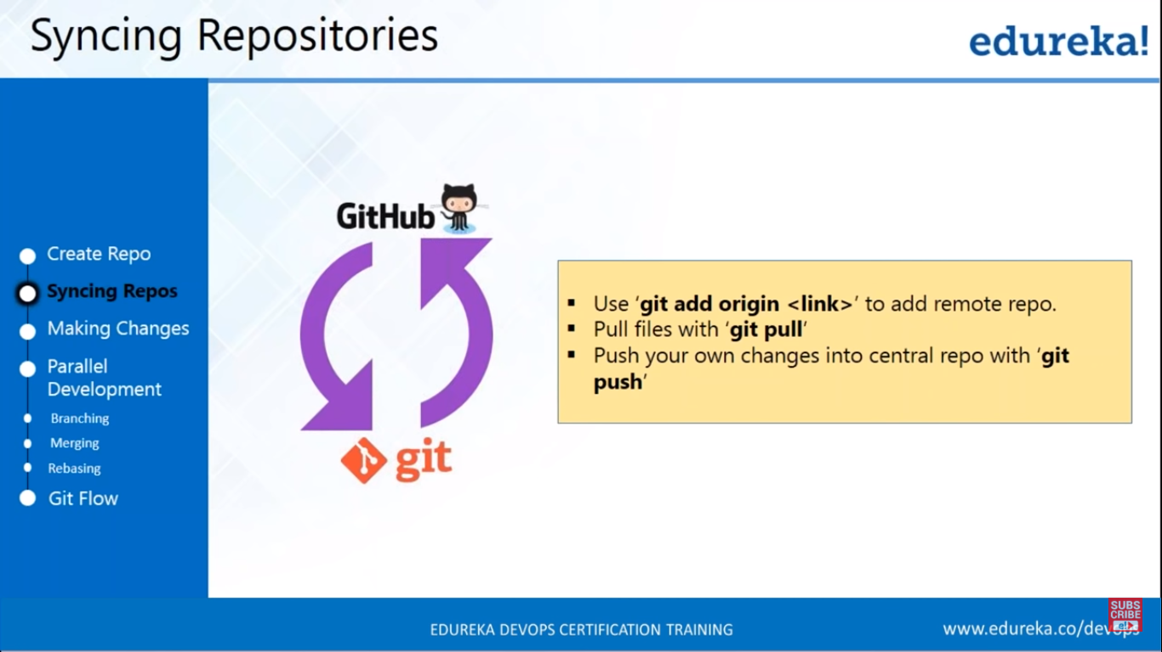

Slide 26
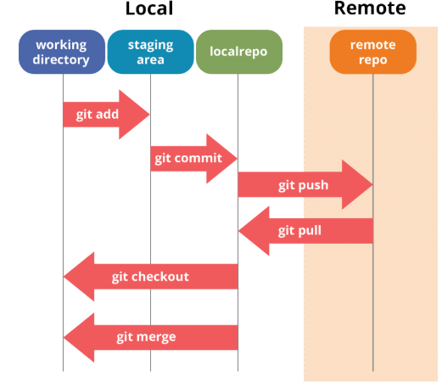
Architecture of GIT

Slide 27
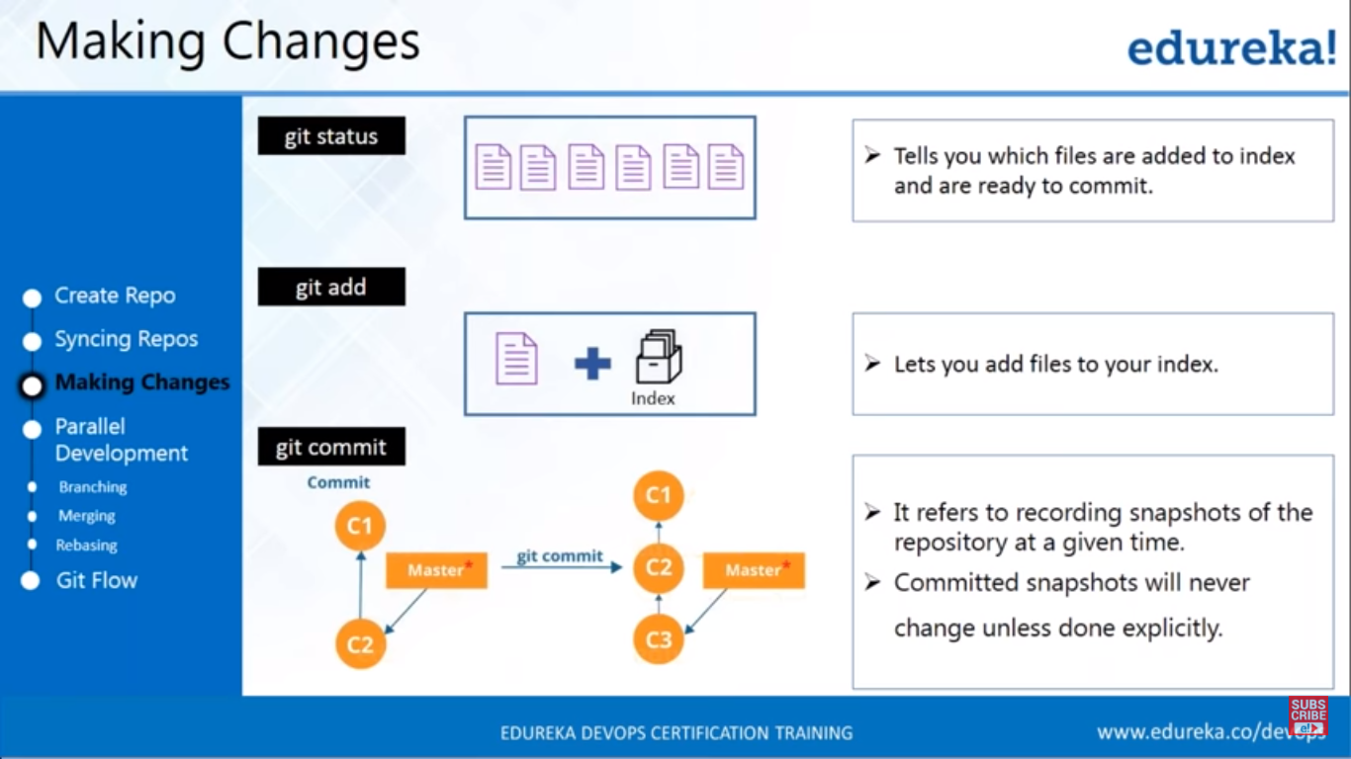

Slide 28
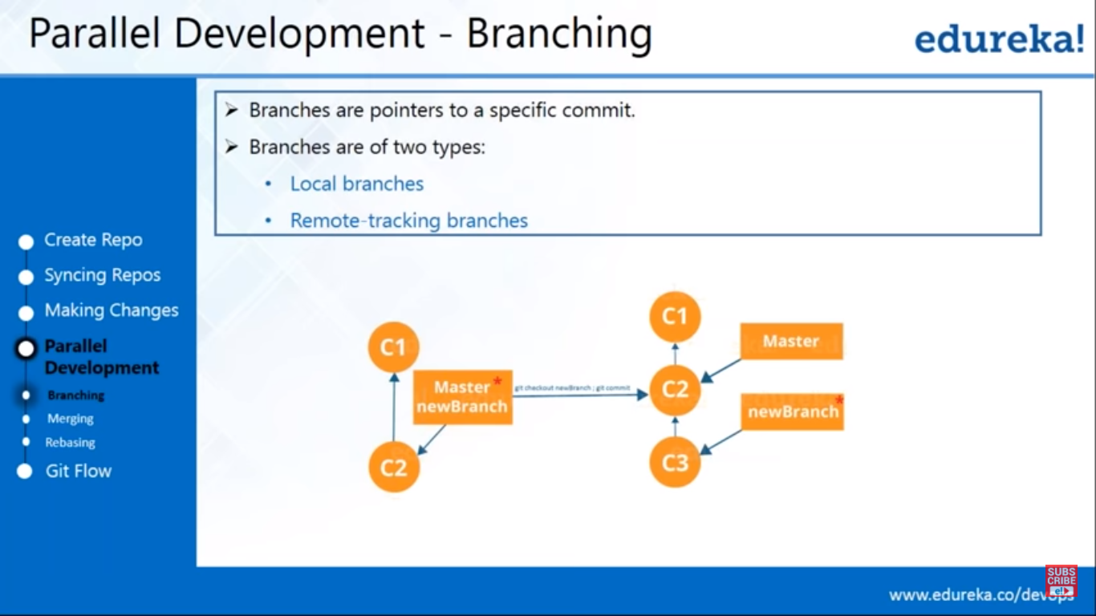

Slide 29
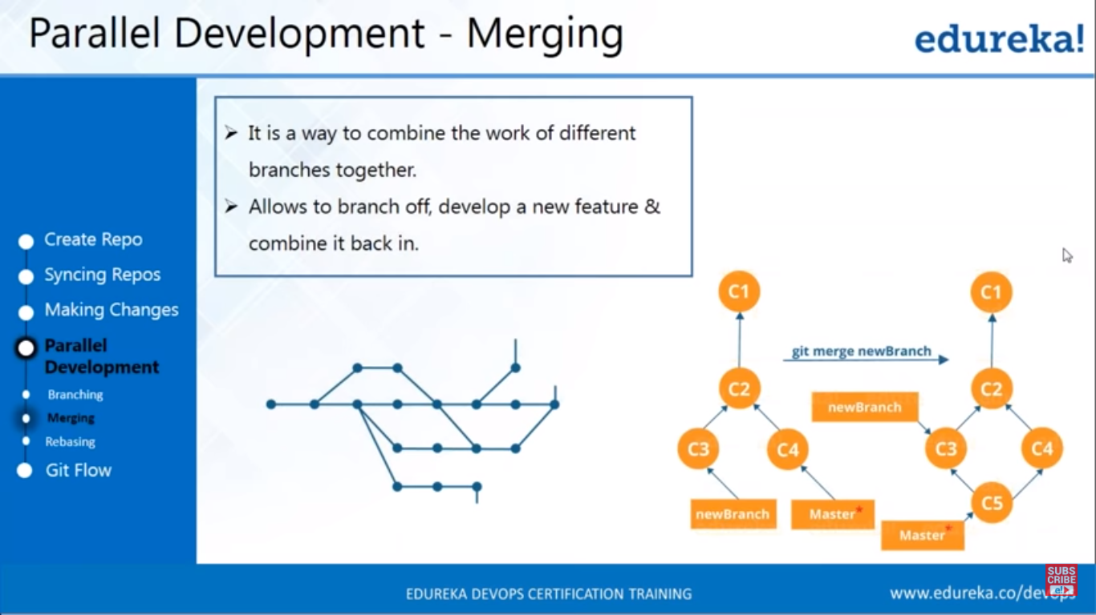

Slide 30
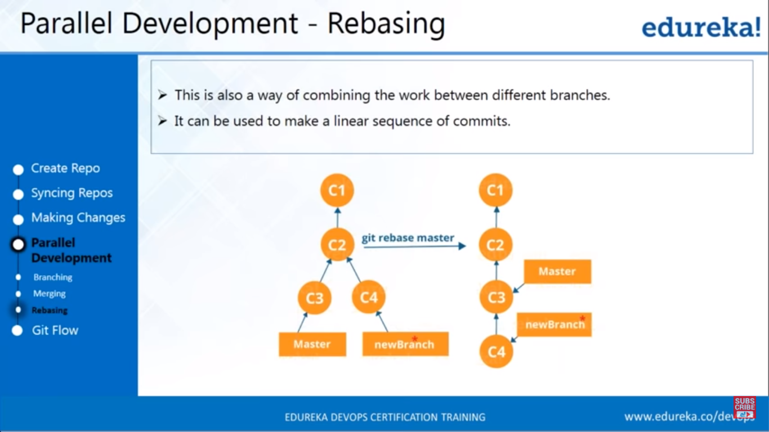

Slide 31
DEMO – GIT COMMANDS

Slide 32
CONTINUOUS INTEGRATION - JENKINS

Slide 33
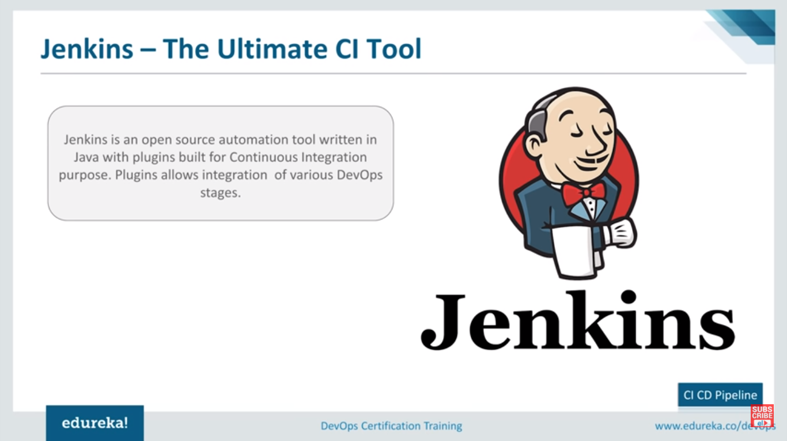
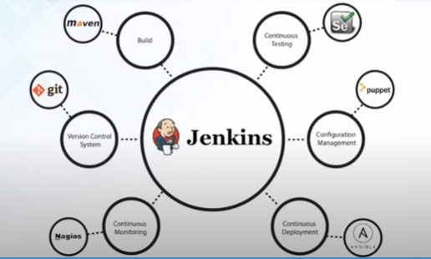

Slide 34
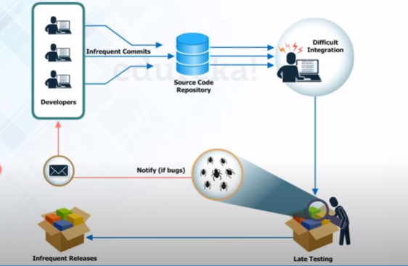
PROCESS BEFORE CONTINUOUS INTEGRATION

Slide 35
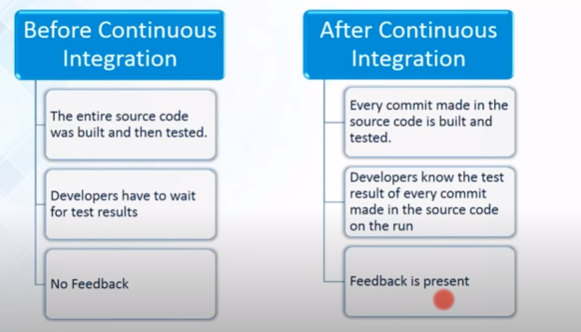
Continuous Integration to rescuse

Slide 36
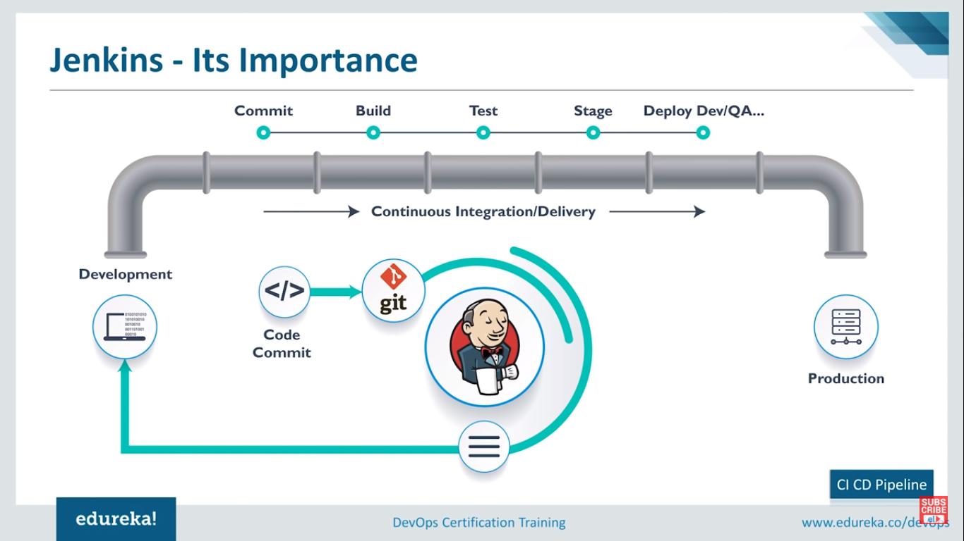

Slide 37
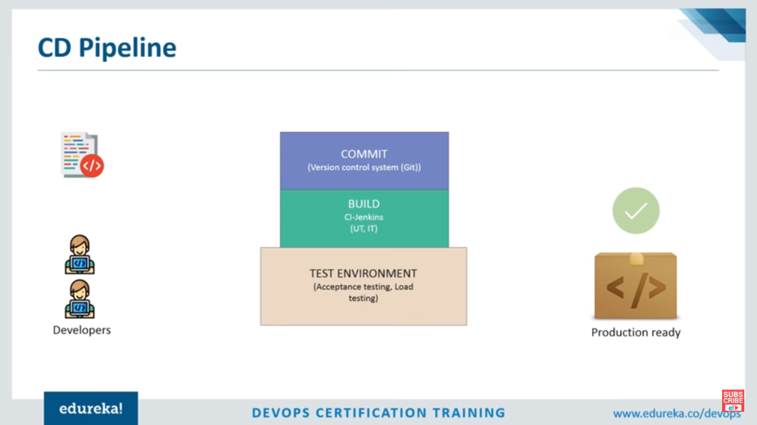

Slide 38
DEMO – CI JENKINS PIPELINE

Slide 39
STATIC TESTING

Slide 40
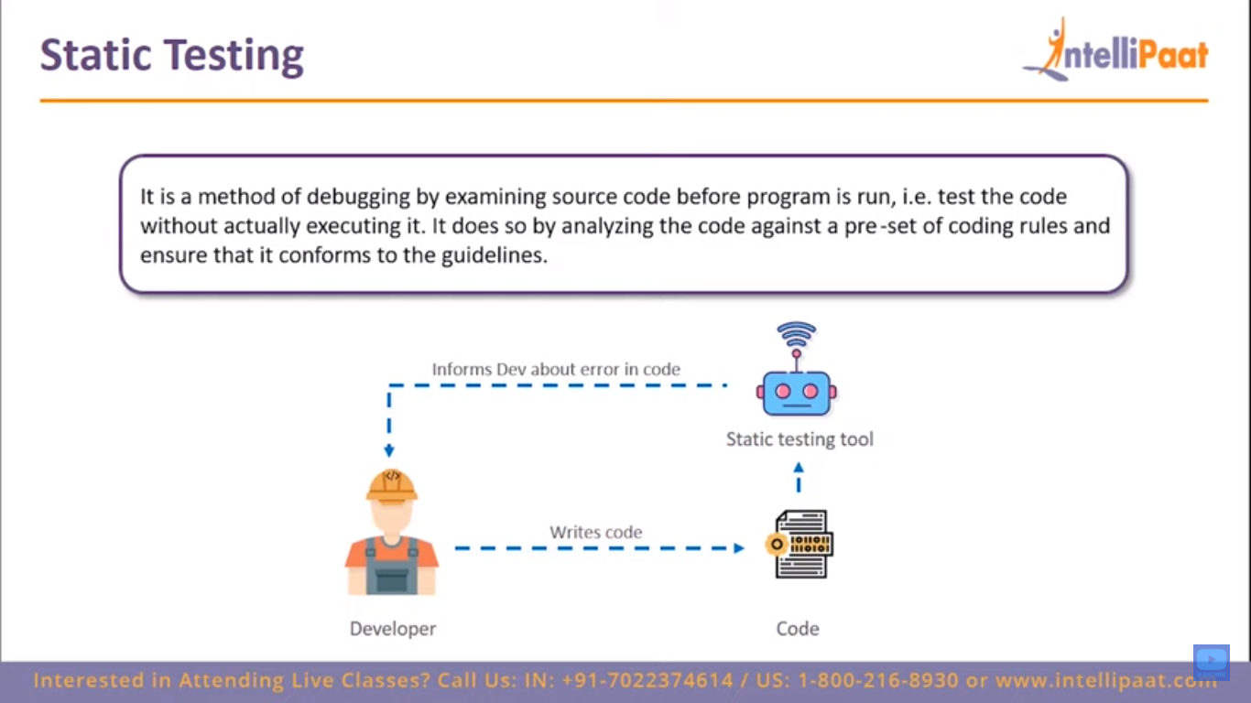

Slide 41
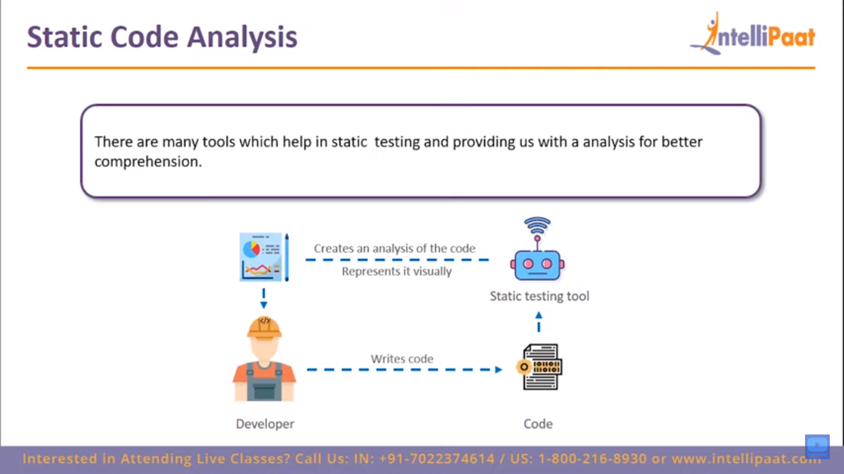

Slide 42
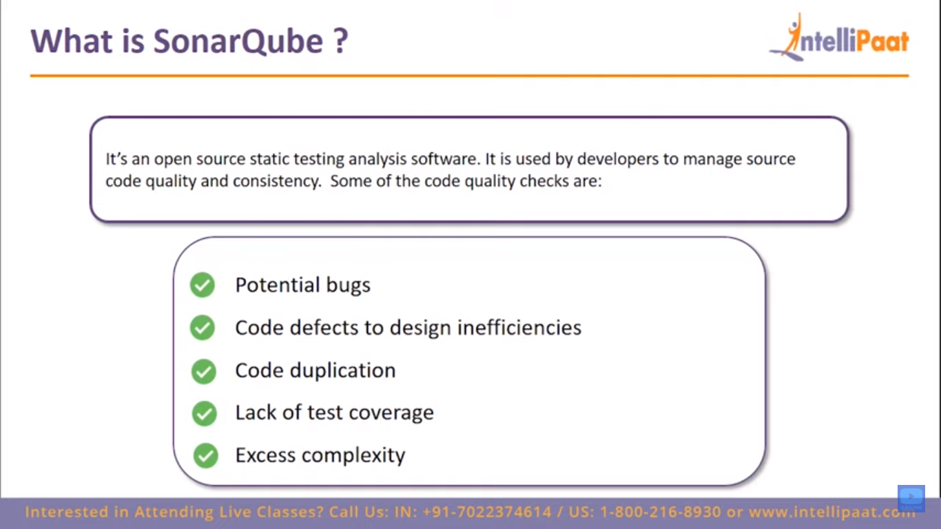

Slide 43
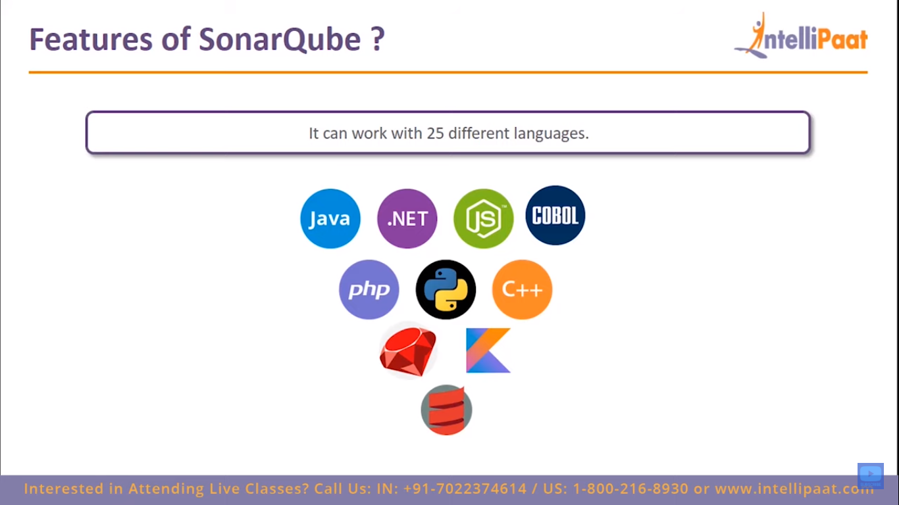

Slide 44
DEMO – SONARQUBE STATIC CODE ANALYSIS

